Slide 1

cv
Emotion Detection Using AI in Restaurants
Weekly Reports
Team Members
1. Anish Singhal
2. Rishi Raj
3. Samhitha P Rao
4. Sarthak Sahu
Under the Guidance of
Nidhishree M S
Assistant Professor, Department of Computer Science and Engineering
Department of Computer Science & Engineering, DSCE

Slide 2
cv
INDEX :
Introduction
Literature Review
Base Paper Analysis
Project Description
Challenges in current work
Conclusions
References
Department of Computer Science & Engineering, DSCE

Slide 3
cv
Nov 1-4: Initiating LLM Development
During this week, our focus was on laying the foundation for our Language Model (LLM) project. We dedicated time to writing the essential code that forms the backbone of the LLM, setting the stage for subsequent phases of development.
We decided to use Deep Learning and Convolutional Neural Network (CNN) for developing the model.
Department of Computer Science & Engineering, DSCE

Slide 4
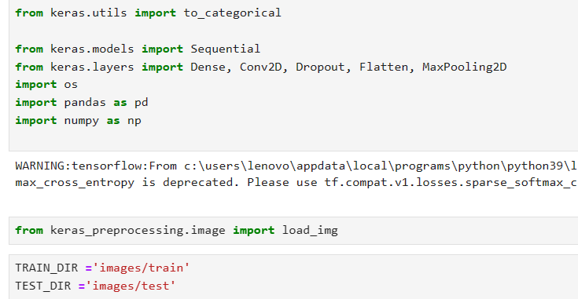
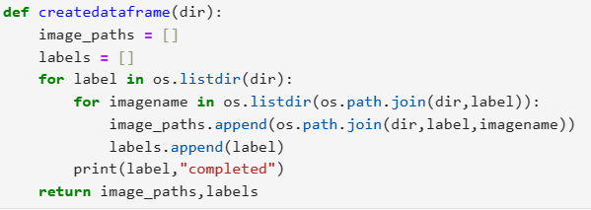
cv
Department of Computer Science & Engineering, DSCE

Slide 5
cv
Nov 6-11: Code Completion and Dataset Exploration
The second week saw significant progress as we completed the core code for the LLM. Simultaneously, efforts were directed towards finding a suitable dataset tailored to our LLM's objectives, ensuring that the model aligns seamlessly with our project requirements.
Department of Computer Science & Engineering, DSCE

Slide 6
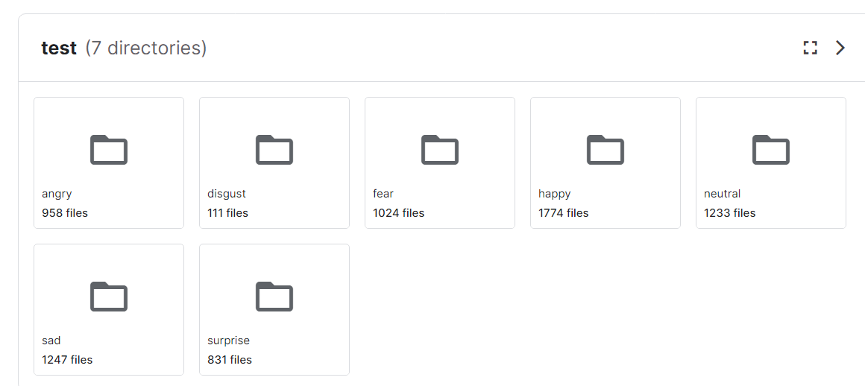
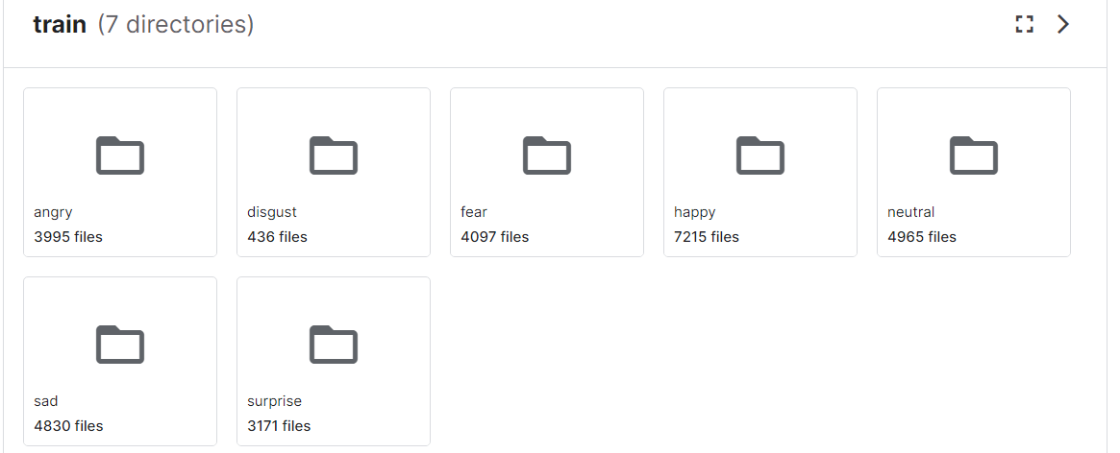
cv
Department of Computer Science & Engineering, DSCE

Slide 7
cv
Nov 13-25: Online Dataset Utilization and Expansion
To augment our dataset, we began utilizing existing online resources for model training. The focus extended to acquiring additional datasets, broadening the scope of the LLM's learning and improving its adaptability to diverse linguistic contexts.
Department of Computer Science & Engineering, DSCE

Slide 8
cv
Department of Computer Science & Engineering, DSCE

Slide 9
cv
Nov 27-30: Formulating Happiness Score Equation
In the final week of November, we shifted our attention to the practical application of our project. Specifically, we dedicated efforts to create an equation for calculating the Happiness Score in a restaurant, a crucial aspect of our LLM's functionality in real-world scenarios
hap += 1
sa += 1
dis += 0.5
sur += 0.5
Rating = ((hap + sur) / (hap + sa + sur + dis)) * 10
Department of Computer Science & Engineering, DSCE

Slide 10
cv
Thank You
Department of Computer Science & Engineering, DSCE

